Slide 1
Recipe Site Traffic
Prepared By: Data Science Team
Notes:
Hi, my name is Alhassan, I am from the Data Science team, and today I am going to present to you how we have approached the problem you gave us of which recipes will be popular 80% of the time and minimize the chances of showing unpopular recipes.

Slide 2
Business Goal
Main Goal:
The main objective is to increase daily subscriptions to our website for a strategic move that contributes to an enhanced brand reputation and higher profitability.
Detailed Objective
Minimize the chance of showing unpopular recipes.
Predict which recipes will lead to high traffic.
Correctly predict high-traffic recipes 80% of the time.
Notes:
Before I talk about what we found, I just want to recap the goals for this project to make sure that we are all aligned. We all know more traffic to our website means more subscriptions, more brand reputation, and higher profitability, we divided the main goal into three detailed objectives:
Minimizing the chance of showing unpopular recipes.
Predicting which recipes will lead to high traffic.
Correctly predicting high-traffic recipes 80% of the time.

Slide 3
Scope of Work
The project scope includes data cleaning, exploratory data analysis, and model development to predict popular recipes for Tasty Bytes, aiming to increase website traffic and subscriptions.
Key tasks involve preparing data, analyzing patterns through EDA, building predictive, and defining metrics to monitor the success of predicting high-traffic recipes.
The project objective is to provide actionable recommendations based on model evaluations and insights to refine recipe selection, enhance user engagement, and drive website traffic and subscription numbers for Tasty Bytes.
Notes:
Let me give you an overview of the scope of the work:
The project includes data cleansing and preparation,
exploratory data analysis,
discovering insights from patterns,
model development,
metrics definition, and
recommendations based on model evaluation and insights.

Slide 4
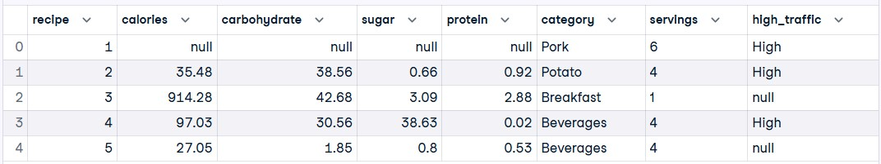
Methodology
Data Validation and Cleansing:
The data includes some missing values, so we performed data cleansing and prepared it for analysis.
Notes:
To address this problem, we used a methodology that includes many steps as follows:
We started by validating the data that you provided to us and found that it has some missing values, some incorrect data types, and some imbalanced data. We did the data cleaning and prepared it for analysis.

Slide 5
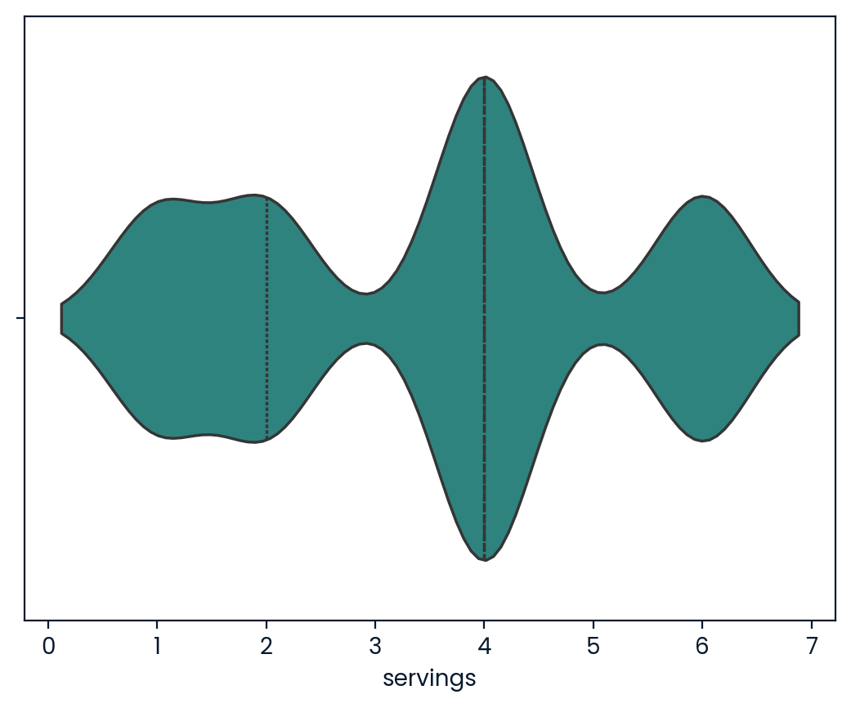
Methodology
Exploratory Data Analysis and Key Findings:
We can see the width of the violin plot which corresponds to the density of data points at that value.
Servings for ‘4’ is the most occurring in our data.
Notes:
Then we discovered some patterns from the data as follows:
Firstly, in this violin plot, we can see that our recipe servings are clustered in servings for 1, 2, 4, and 6, and most servings are for 4. This shows some imbalance in our data, as we cannot see any servings for 3 and 5!

Slide 6
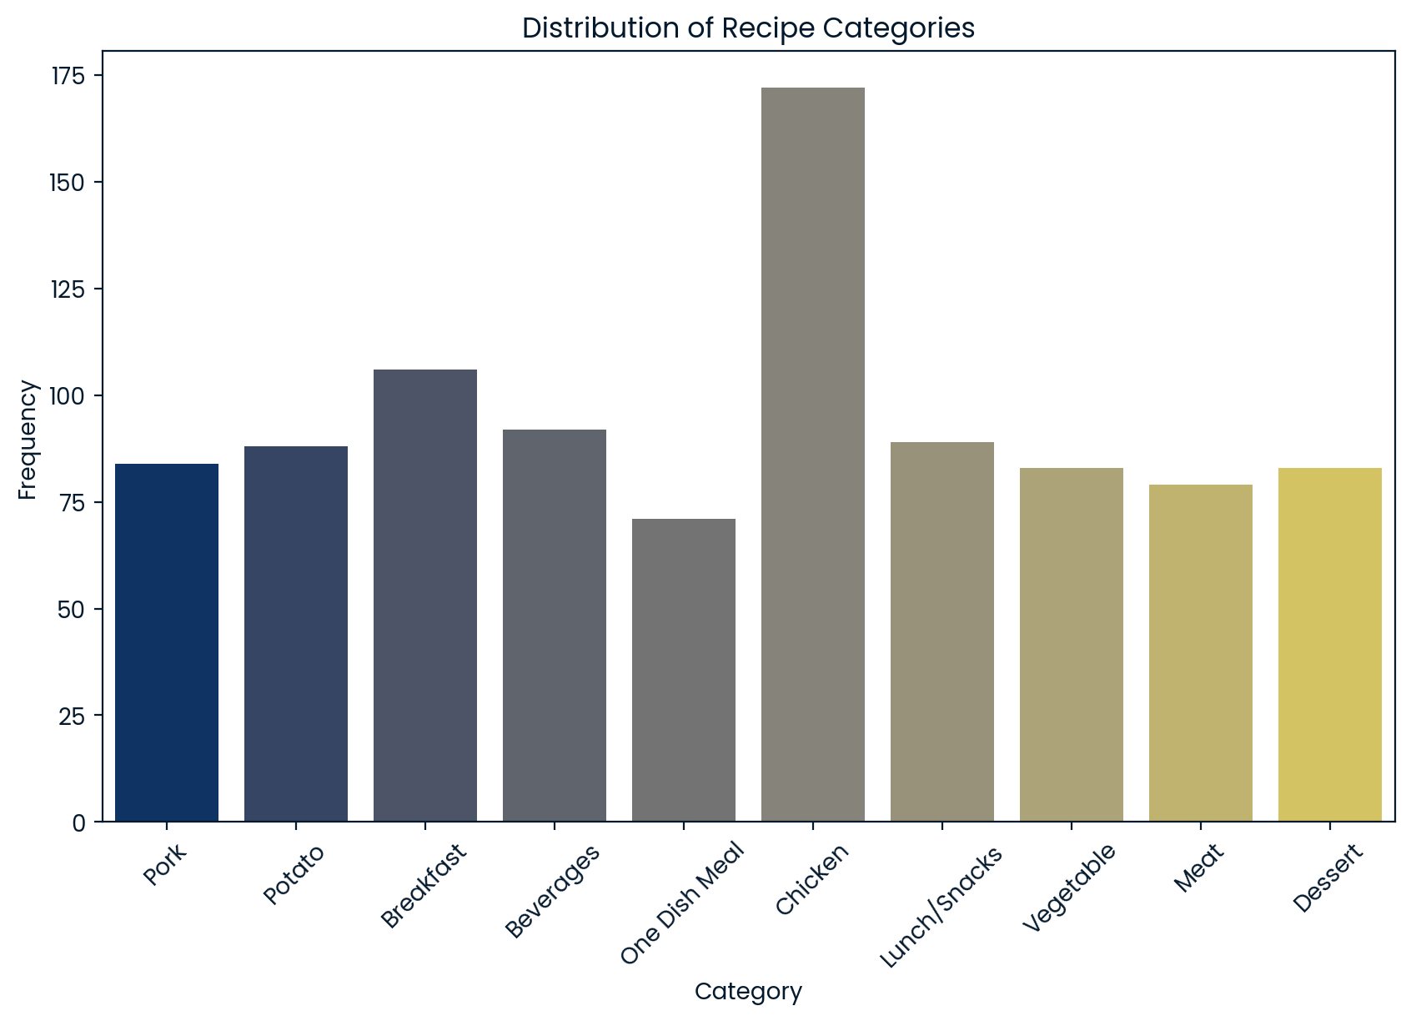
Methodology
Exploratory Data Analysis and Key Findings:
The "Chicken" category has the highest number of recipes, just less than 175, while the other categories show a relatively even distribution, with recipe counts ranging from approximately 70 to just under 110.
Notes:
Secondly, in the bar plot, we see that the Chicken category has the highest number of recipes, while the other categories show a relatively even distribution, with recipe counts ranging from 70 to just less than 110. So, this feature “category” plays a crucial role in determining the common recipe, as its data are balanced, except for the Chicken category which can be considered as an outlier.

Slide 7
Methodology
Models Development
Calories
Carbohydrate
Sugar
Protein
Category
Servings
High
Logistic Regression
Low
XGB Classifier
High
Low
Notes:
Now I am going to talk about model development:
We decided to try two different models to address this problem to see how each performs.
The first is the Logistic Regression model which is simple to implement and interpret, and the second is the XGB Classifier model which has high predictive accuracy. Both models will classify the result as binary, either High traffic or low.

Slide 8
Methodology
Logistic Regression Model
Metrics
True Positives (TP): 99 instances where the actual class is High, and the model correctly predicted High.
True Negatives (TN): 61 instances where the actual class is Low, and the model correctly predicted Low.
False Positives (FP): 14 instances where the actual class is Low, but the model incorrectly predicted High.
False Negatives (FN): 16 instances where the actual class is High, but the model incorrectly predicted Low.
Confusion Matrix |  | Predicted
 |  | Low | High
Actual | Low | 61 | 14
 | High | 16 | 99
Accuracy: 84%
Classification Report:
For Class Low: precision 0.79, recall 0.81, f1-score 0.80
For Class High: precision 0.88, recall 0.86, f1-score 0.87
Notes:
Let us see what we did to measure model performance and evaluate it:
We used Accuracy, Confusion Matrix, Classification Report, and False Positive Ratio to assess both models.
This is the result of the Logistic Regression Model

Slide 9
Methodology
XGB Classifier Model
Metrics
True Positives (TP): 97 instances where the actual class is High, and the model correctly predicted High.
True Negatives (TN): 54 instances where the actual class is Low, and the model correctly predicted Low.
False Positives (FP): 21 instances where the actual class is Low, but the model incorrectly predicted High.
False Negatives (FN): 18 instances where the actual class is High, but the model incorrectly predicted Low.
Confusion Matrix |  | Predicted
 |  | Low | High
Actual | Low | 54 | 21
 | High | 18 | 97
Accuracy: 79%
Classification Report:
For Class Low: precision 0.75, recall 0.72, f1-score 0.73
For Class High: precision 0.82, recall 0.84, f1-score 0.83
Notes:
This is the result of the XGB Classifier Model

Slide 10
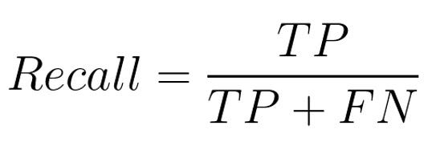
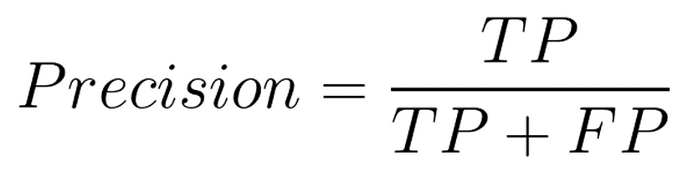
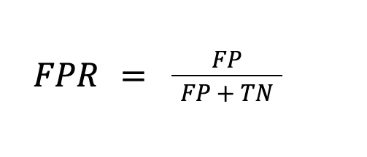
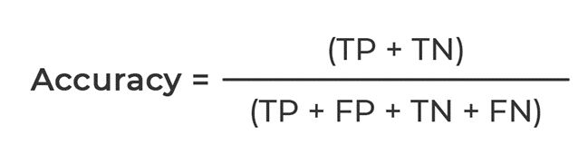
Methodology
Metrics
Notes:
These are the equations of the metrics that we used.
Recall: evaluates how well the model identifies high-traffic recipes from all recipes that are truly high-traffic.
Precision: evaluates how many of the recipes predicted as high-traffic are actually high-traffic recipes.
False Positive Ratio: evaluates how many of the low-traffic recipes are incorrectly predicted as high-traffic recipes out of all the actual low-traffic recipes.
Accuracy: evaluates the overall correctness of the model by measuring the proportion of correctly predicted high-traffic and low-traffic recipes out of the total number of recipes.

Slide 11
Outcome
Correctly predict high-traffic recipes 80% of the time:
Both models achieve over 80% of the time (Recall of High), but the Logistic Regression has a slightly higher recall of 86%, while the XGB Classifier is only 84%.
Predict which recipes will lead to high traffic:
The Logistic Regression model has a higher precision of 88% compared to XGB Classifier’s 82%.
Minimize the chance of showing unpopular recipes:
The Logistic Regression model has a lower false positive rate of 18.7% compared to the XGB Classifier's 29.3%.
However, when considering the overall accuracy:
The Logistic Regression model scores 84%, while the XGB Classifier achieves a score of 79%.
Notes:
Here we match our detailed objectives against the results of both models:
For correctly predicting high-traffic recipes 80% of the time: Both models have successfully surpassed this objective by scoring a recall of over 80%, but the Logistic Regression performed better with 86% recall.
To predict which recipes will lead to high traffic: Logistic Regression performs better with 88% precision.
To Minimize the chance of showing unpopular recipes: Logistic Regression performs better with a lower false positive ratio of 18.7%.
However, when considering the overall correctness of the model:
The Logistic Regression model scores 84%, while the XGB Classifier achieves only a score of 79%.

Slide 12
Recommendation
Evaluate the Logistic Regression model using actual traffic data for the initial month.
Identify any errors that might arise to improve the metrics of the model.
Deploy the Logistic Regression, using an efficient deployment strategy.
Continuous improve the model by collecting more data, applying feature engineering, and fine-tuning parameters.
Notes:
Now we have seen what we have managed to achieve in just a few weeks. I want to finish with some recommendations for what we should do next. Assuming you are happy with everything you have seen today:
Our first recommendation would be to test the Logistic Regression model with your team, we would like to compare how the model performs with real data over the next month.
After this, we can make plans about how to fully deploy the model.
After launching the model we should continue to improve it.

Slide 13
Thank You
Notes:
Thank you so much for your time today. Please reach out to me if you have any questions.

